Slide 1
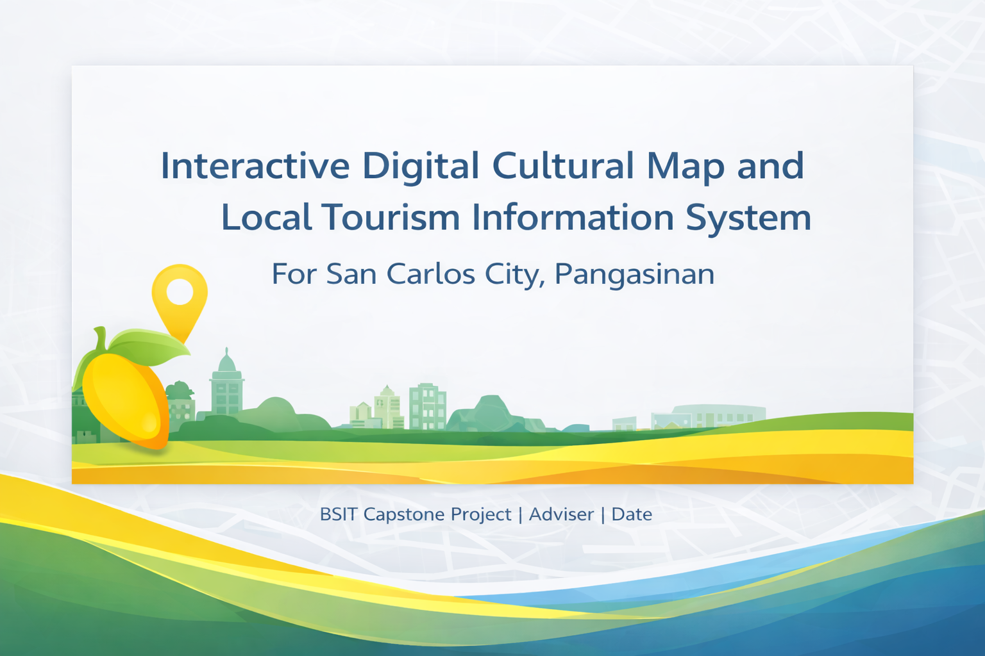
MEMBERS:
NOIME D. TANGIHAN
JAYSOHN M.BANAAG
JESZEL ANNE LAYAOG
JEROME LAYACAN

Slide 2

Project Overview
A web-based information system that consolidates:
Tourism destinations (hotels, resorts, restaurants, attractions)
Cultural heritage sites (history, stories, location)
Interactive map managed by the City Tourism Office
Designed to support tourism promotion, public information, and data-driven reporting for San Carlos City.

Slide 3
I. Company Background and Contact Person

Slide 4
Background: Residents of San Carlos City (Different Barangays)
San Carlos City is a component city in Pangasinan with 86 barangays (30 urban, 56 rural).
Population is 205,424 (2020 Census), showing a large community that can benefit from accessible local heritage and tourism information.
Residents are key partners because many cultural stories, locations, and community events are locally held/known and can be documented and promoted responsibly

Slide 5
Background: San Carlos City Local Tourism Office
The City Tourism Office is part of the city government structure and is responsible for local tourism promotion, coordination, and information support.
The city positions itself toward being an Agro-Industrial, Education and Tourism Center, strengthening the need for organized tourism information systems.

Slide 6
Contact Person (Tourism Office Head)
Ms. Ruby DG. Ballesteros
Tourism Officer Designate, San Carlos City, Pangasinan
Office coordination point for validation, approvals, and official publishing of tourism/cultural information.

Slide 7
Background: Tourists / Visitors
Tourists need reliable, complete, and official information on:
attractions, routes, operating hours, contacts
cultural heritage narratives and site locations
A curated city-managed platform reduces confusion from inconsistent online posts and incomplete map entries.

Slide 8
II. Issues and Challenges Identified

Slide 9
Current Issues
Tourism info not readily available: hotels, resorts, restaurants, attractions are scattered across posts/pages; difficult to verify/update.
Cultural heritage info not readily available: residents and visitors have limited access to consolidated local history and cultural site context.
Google Map entries are incomplete/inconsistent: user-generated pins may be missing, duplicated, or outdated; no centralized local management.
Tourism and culture are not formally promoted in one official hub: promotion is fragmented across different channels.
Manual data collection and reporting: registrations and summaries are often manual, limiting analytics and timely decisions.
No standard process for validation: difficulty confirming legitimacy/accuracy of destination details and cultural narratives before publication.

Slide 10
III. Main Objective / Purpose of the Computing Solution

Slide 11
General Objective
To develop a web-based interactive digital cultural map and tourism information system for San Carlos City that centralizes, verifies, and publishes tourism and cultural heritage information for residents, tourists, and the City Tourism Office.

Slide 12
Specific Objectives
Support tourism and cultural promotion through an official, accessible platform aligned with the city’s tourism direction.
Help tourists and residents search and contact local establishments (hotels, resorts, restaurants, attractions) using verified details.
Provide a managed interactive map featuring tourist destinations and cultural sites (with categories, filters, and accurate pins).
Increase awareness of the city’s culture and identity (e.g., local heritage narratives and festivals such as the Mango-Bamboo Festival).
Enable the Tourism Office to publish articles/announcements and generate reports (registrations, listings, trends).

Slide 13
IV. Scope of the System / Computing Solution

Slide 14
Scope
Tourism Destinations & Establishments Management
details, contacts, images, categories, status, map coordinates
Cultural Sites Management
history/description, images, coordinates, cultural tags
Interactive Map Module (Manageable)
view layers (tourism vs culture), filters, pinned locations, link to details
Search & Discovery (Tourist/Resident)
keyword search, category filters, “near me” (optional), map-based search
Articles / Tourism & Culture Publishing
facts, activities, programs, events (office-approved publishing)
Tourist Registration
online registration, visit details, purpose; viewable for tourism assistance
Reports (Admin/Staff)
printable lists/summary reports for destinations, sites, and registrations

Slide 15
Out of Scope
Online booking and payment processing (future enhancement)
Full travel itinerary automation (future enhancement)
Mobile native app (optional future; system is web-based first)

Slide 16
V. Users of the Computing Solution

Slide 17
User Roles
Tourist / Residents (Web Users)
view map, search destinations, read articles, register as tourist
City Tourism Office Staff
encode/update tourism and cultural records, upload gallery, publish posts (with approval flow)
City Tourism Office System Administrator
manage staff accounts/roles, web settings, full access to reports and content moderation

Slide 18
VI. Stakeholders

Slide 19
Stakeholders and How They Benefit
City Tourism Office
centralized data, formal publishing, reporting, improved visitor support
Tourists
trusted info source, easier discovery and navigation
Residents of San Carlos City
greater awareness of local heritage and city identity; community pride
Developers / Researchers
applied experience in GIS/map systems, content management, and information systems deployment

Slide 20
VII. Use Cases

Slide 21
Key Use Cases
Tourist registers to help the Tourism Office understand visitor needs and possible assistance.
Tourist/resident searches for hotels, resorts, restaurants, and attractions within San Carlos City.
Tourist/resident views the tourism and cultural map to locate sites and learn history/cultural context.
Tourism staff updates destination/site details and publishes official announcements/articles.
Administrator creates staff accounts, manages access roles, and generates printable reports.

Slide 22
VIII. Hardware, Software, and Service Requirements (Bullets Only)

Slide 23
HSS Requirements
Development
Code Editor: Sublime Text / VS Code
Database: MySQL / MariaDB
Languages: PHP, HTML, CSS, JavaScript, SQL
Local Server: WAMP/XAMPP
Browser: Google Chrome
OS/Hardware: Windows 10/11, Core i5 laptop (or equivalent)
Deployment (Online)
Web hosting (LAMP stack / PHP + MySQL support)
Domain name registration
SSL certificate (HTTPS)
Optional: Google Maps API key or OpenStreetMap + Leaflet integration
User Access
Mobile phone / tablet / laptop / desktop
Mobile/desktop browsers
Stable internet connection / mobile data

Slide 24
IX. Methodology (Simple Agile)

Slide 25
Suggested Methodology: Scrum (Lightweight Agile)
Why Scrum fits
Best for capstone projects where requirements evolve during stakeholder feedback
Delivers usable outputs in short cycles (sprints) for panel and client review
Phases mapped to this project
Product Backlog
list features: destinations, cultural sites, map, articles, registration, reports
Sprint Planning (1–2 weeks/sprint)
choose what to build next (e.g., Sprint 1: login + destinations CRUD)
Sprint Development
build + test modules incrementally (map integration can be Sprint 2/3)
Sprint Review
demo to Tourism Office representative; collect revisions
Sprint Retrospective
improve workflow, fix blockers, refine coding standards
Release / Deployment
final hosting + data seeding + user orientation

Slide 26
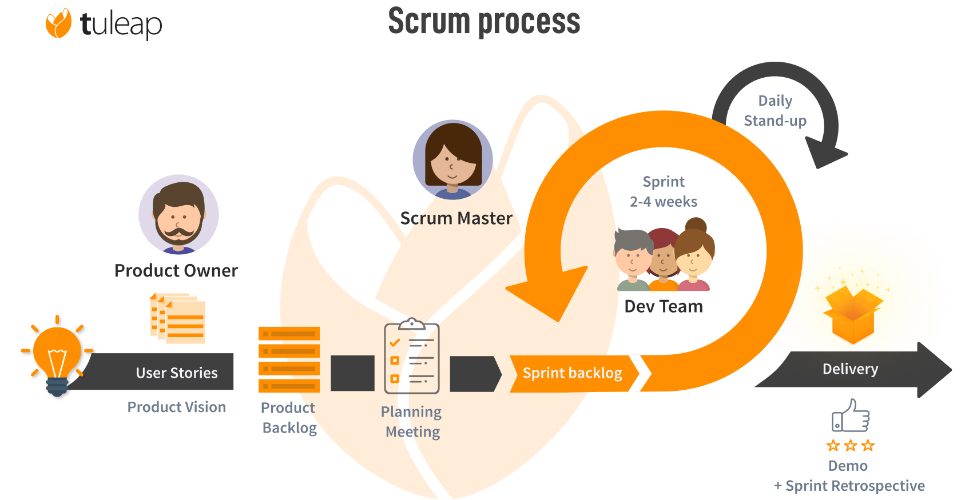
Suggested Methodology: Scrum (Lightweight Agile)

Slide 27
X. Flowcharts (Text Layout + Mermaid Code)

Slide 28
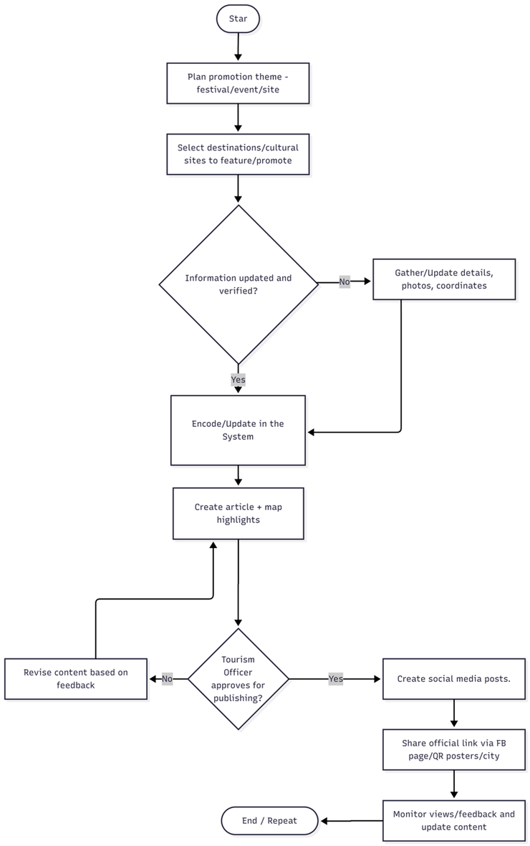
Flowchart: Process of Promoting Local Tourism and Cultural Sites

Slide 29
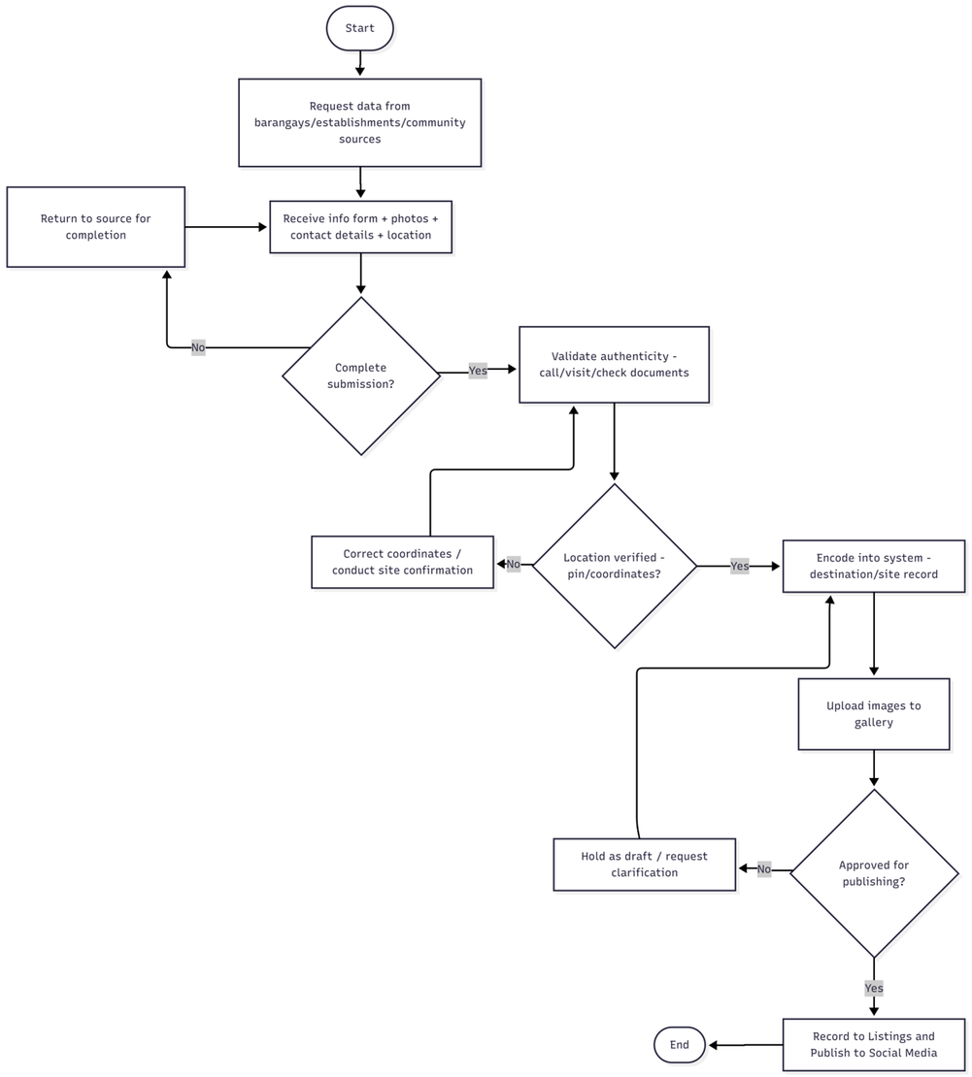
Flowchart: Process of Gathering Info (Tourist Destinations & Cultural Sites)

Slide 30
X. Entity Relationship Diagram

Slide 31
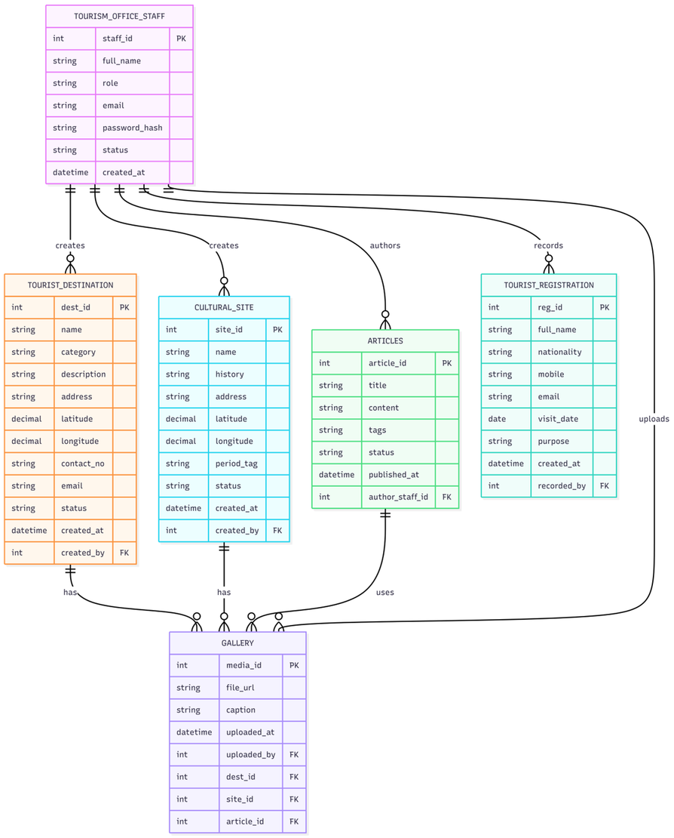
Entity Relationship Diagram (ERD)

Slide 32
XI. Data Flow Diagram

Slide 33
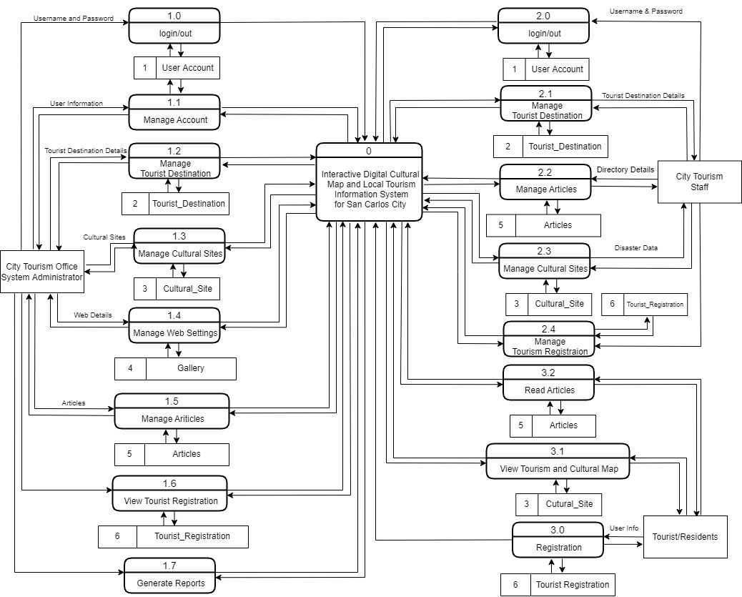
Data Flow Diagram

Slide 34
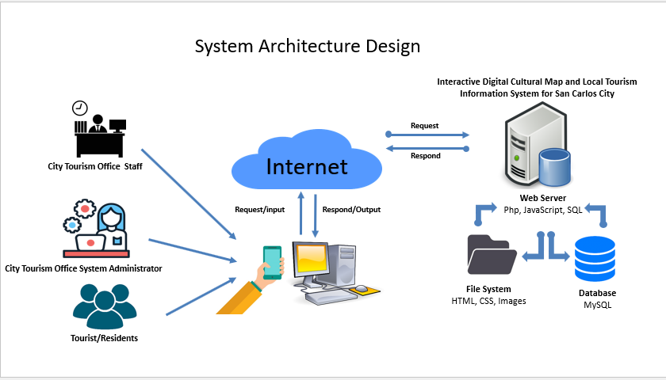

Slide 35









System Architecture Design
Interactive Digital Cultural Map and Local Tourism Information System for San Carlos City
Request
Internet
Respond
City Tourism Office Staff
Web Server
Php, JavaScript, SQL
Request/input
Respond/Output
City Tourism Office System Administrator
File System
HTML, CSS, Images
Database
MySQL
Tourist/Residents

Slide 36


